Slide 1
Publicis Sapient

Slide 2
Online Cash Deposit Form in Banks
Server Based Application
~ Aryan Sahu

Slide 3

Agenda
1
Objective
2
Problem Statement
3
Technology Stack
4
DadaDog
5
ServiceNow
Publicis
Sapient

Slide 4

Objective
To develop a secure and user-friendly online cash deposit form system for banks that enhances customer experience, streamlines cash deposit processes, and provides real-time tracking and reporting.
Publicis
Sapient

Slide 5

Problem Statement
Traditional cash deposit processes in banks are slow and inefficient, causing customer frustration. Long wait times and complex procedures hinder satisfaction, while banks struggle with real-time tracking and compliance.
To address these challenges, we will implement a technology stack (HTML, CSS, JavaScript, Node.js, MongoDB, Docker, and Datadog) for a secure online cash deposit system, enabling rapid development and scalability. Additionally, ServiceNow will be used for incident and change management, streamlining operations.
Publicis
Sapient

Slide 6
TECHNOLOGY STACK

Slide 7
TECHNOLOGY STACK
FRONTEND
HTML
CSS
Styling
BACKEND
JS & NODE
DOCKER
Container, Images
SRE
Reliability, Scalability, Performance of systems
ServiceNOW
Automate IT Services and
Incidents, change
Publicis
Sapient

Slide 8


DOCKER:
Kubernetes:
Docker is a platform that enables developers to automate the deployment of applications inside lightweight, portable containers, allowing for consistent environments across development, testing, and production.
While Docker can run multiple containers on a single machine, but it doesn’t handle organizing or scaling them across many machines.
Kubernetes manages and coordinates multiple containers across many machines, ensuring they work together properly and can scale up or down as needed.
Publicis
Sapient

Slide 9
Implementation

Slide 10

IMPLEMENTATION
Write a docker file for NodeJS
Docker Image needs to be displayed in docker desktop.
Write a docker-compose.yml file, to build the images and containers (multiple services).
Publicis
Sapient

Slide 11
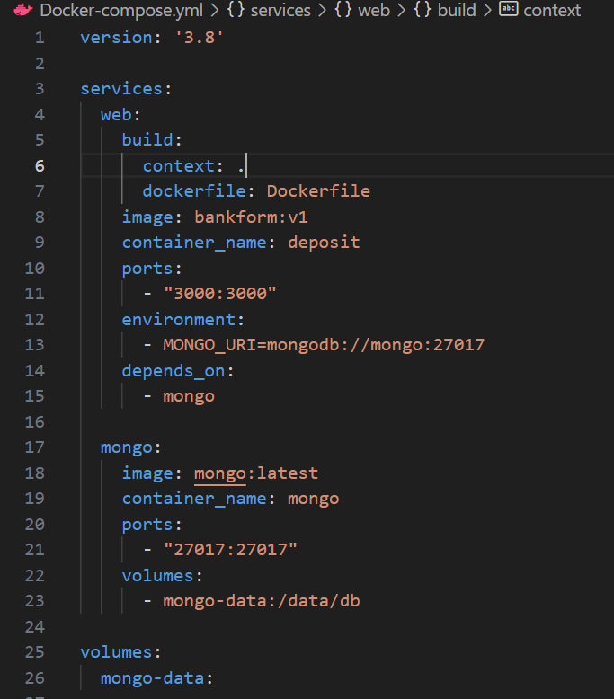
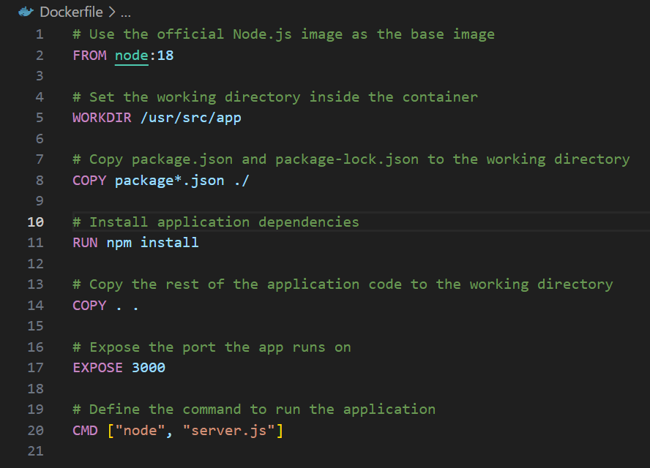
Dockerfile
Docker-Compose.yml
Publicis
Sapient

Slide 12
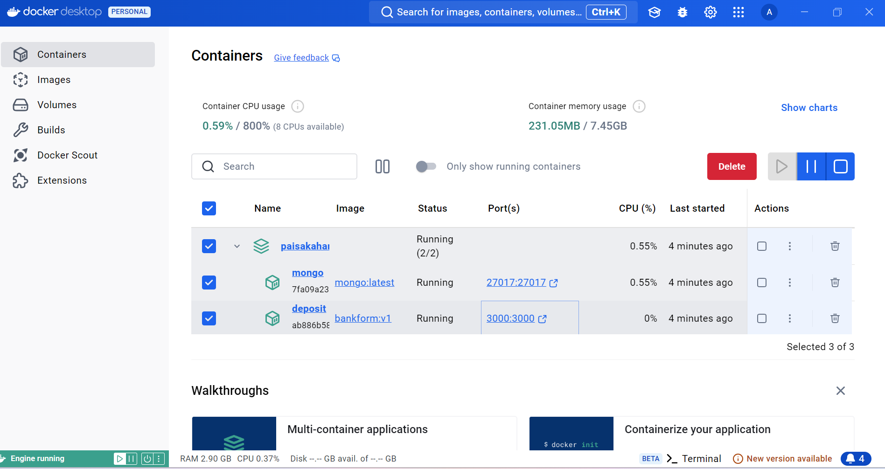
Publicis
Sapient

Slide 13
Application Deployment

Slide 14
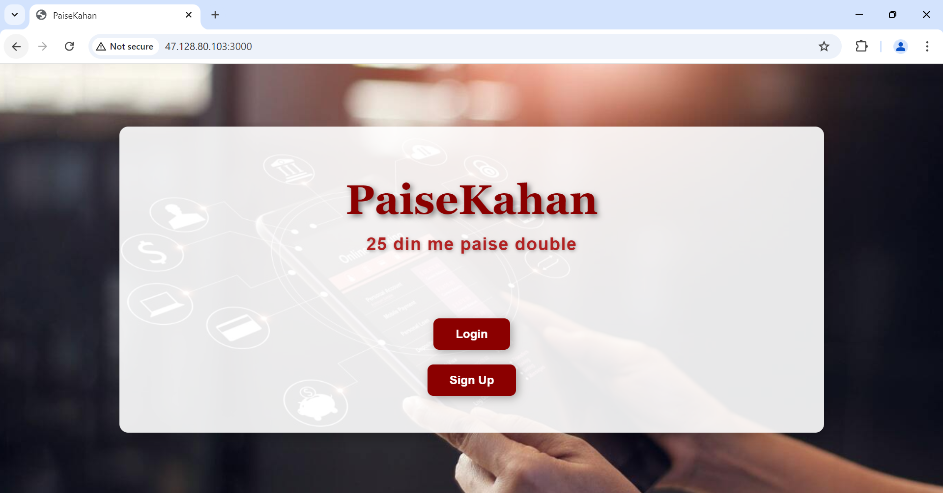

Slide 15
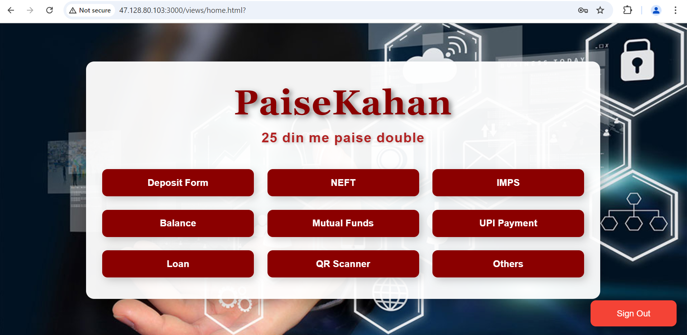

Slide 16
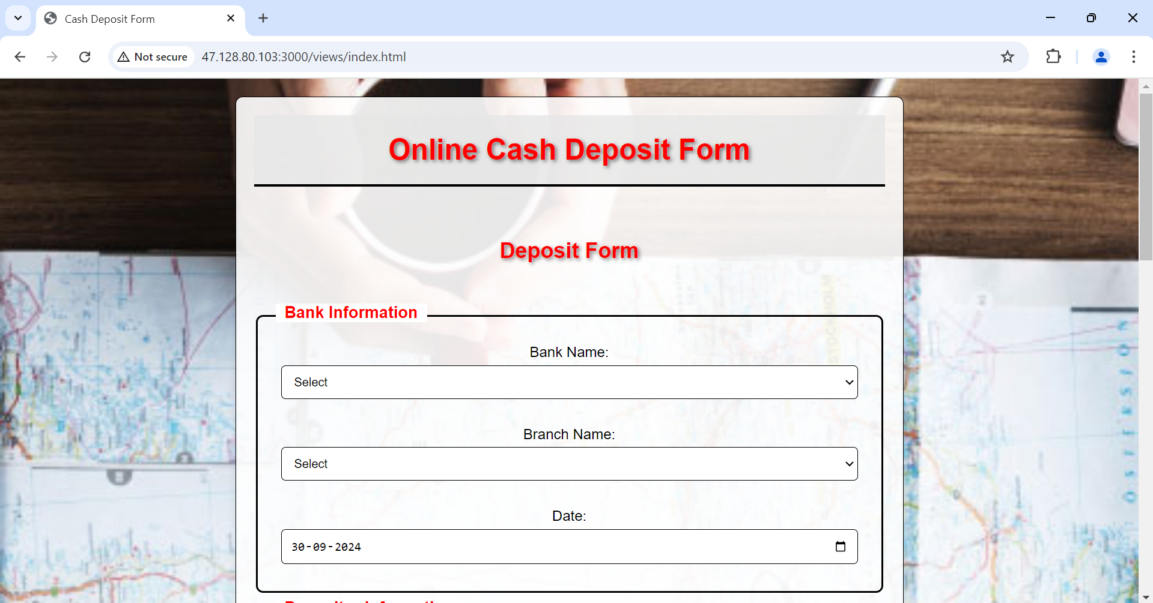

Slide 17
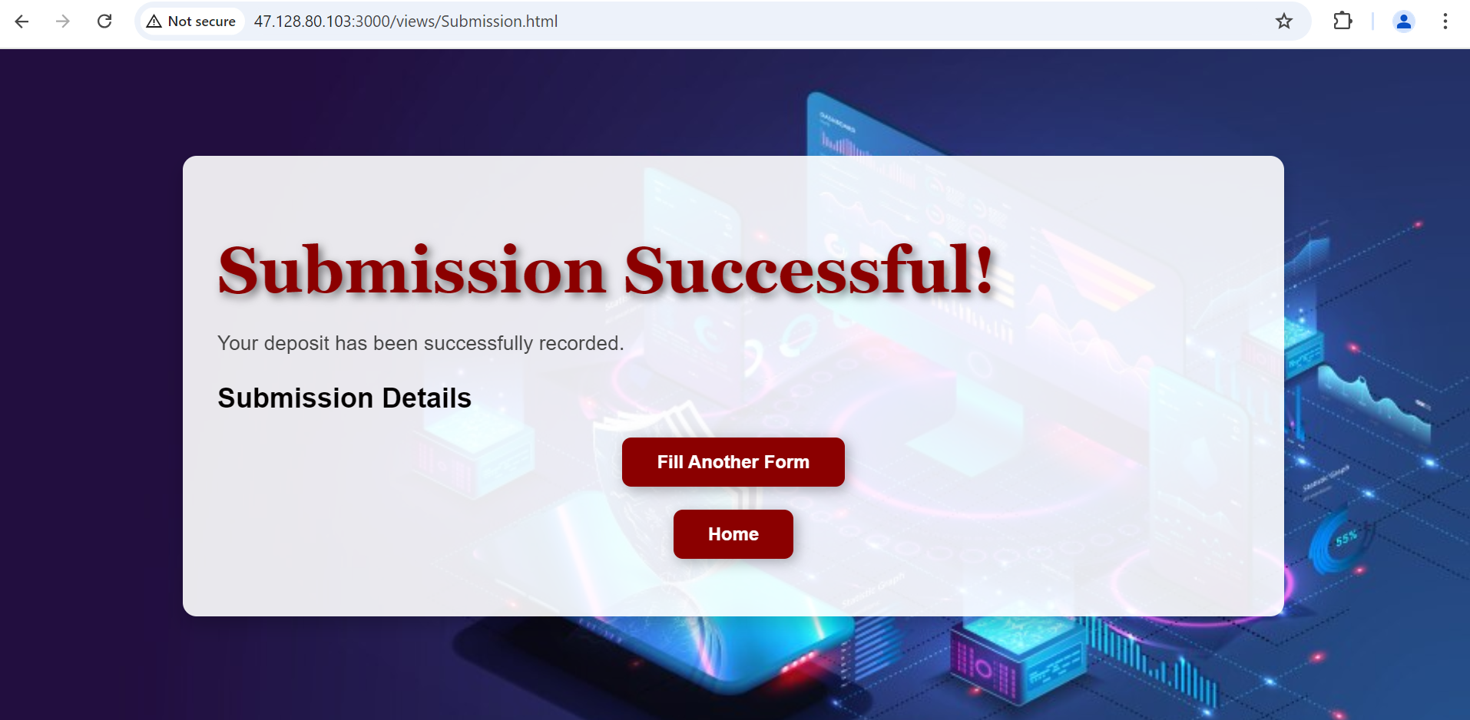

Slide 18
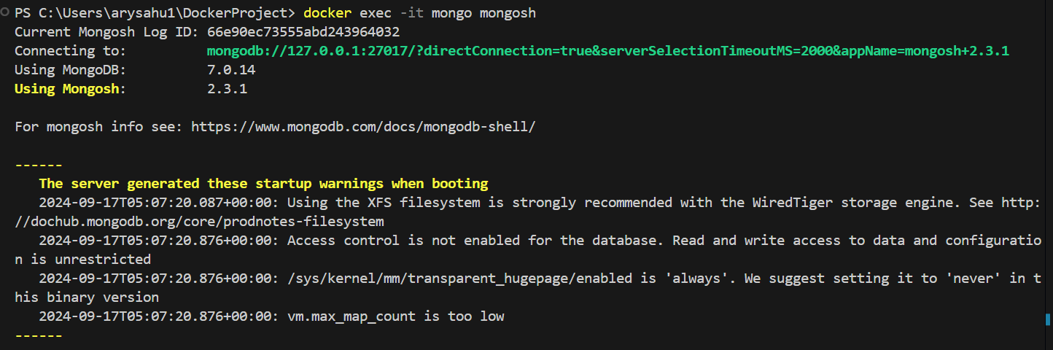
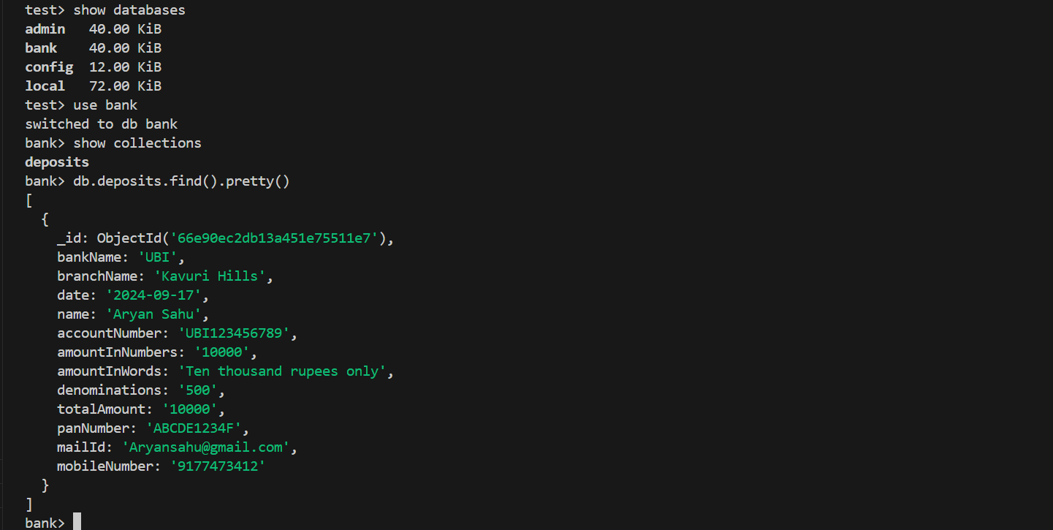
MongoDB
Publicis
Sapient

Slide 19
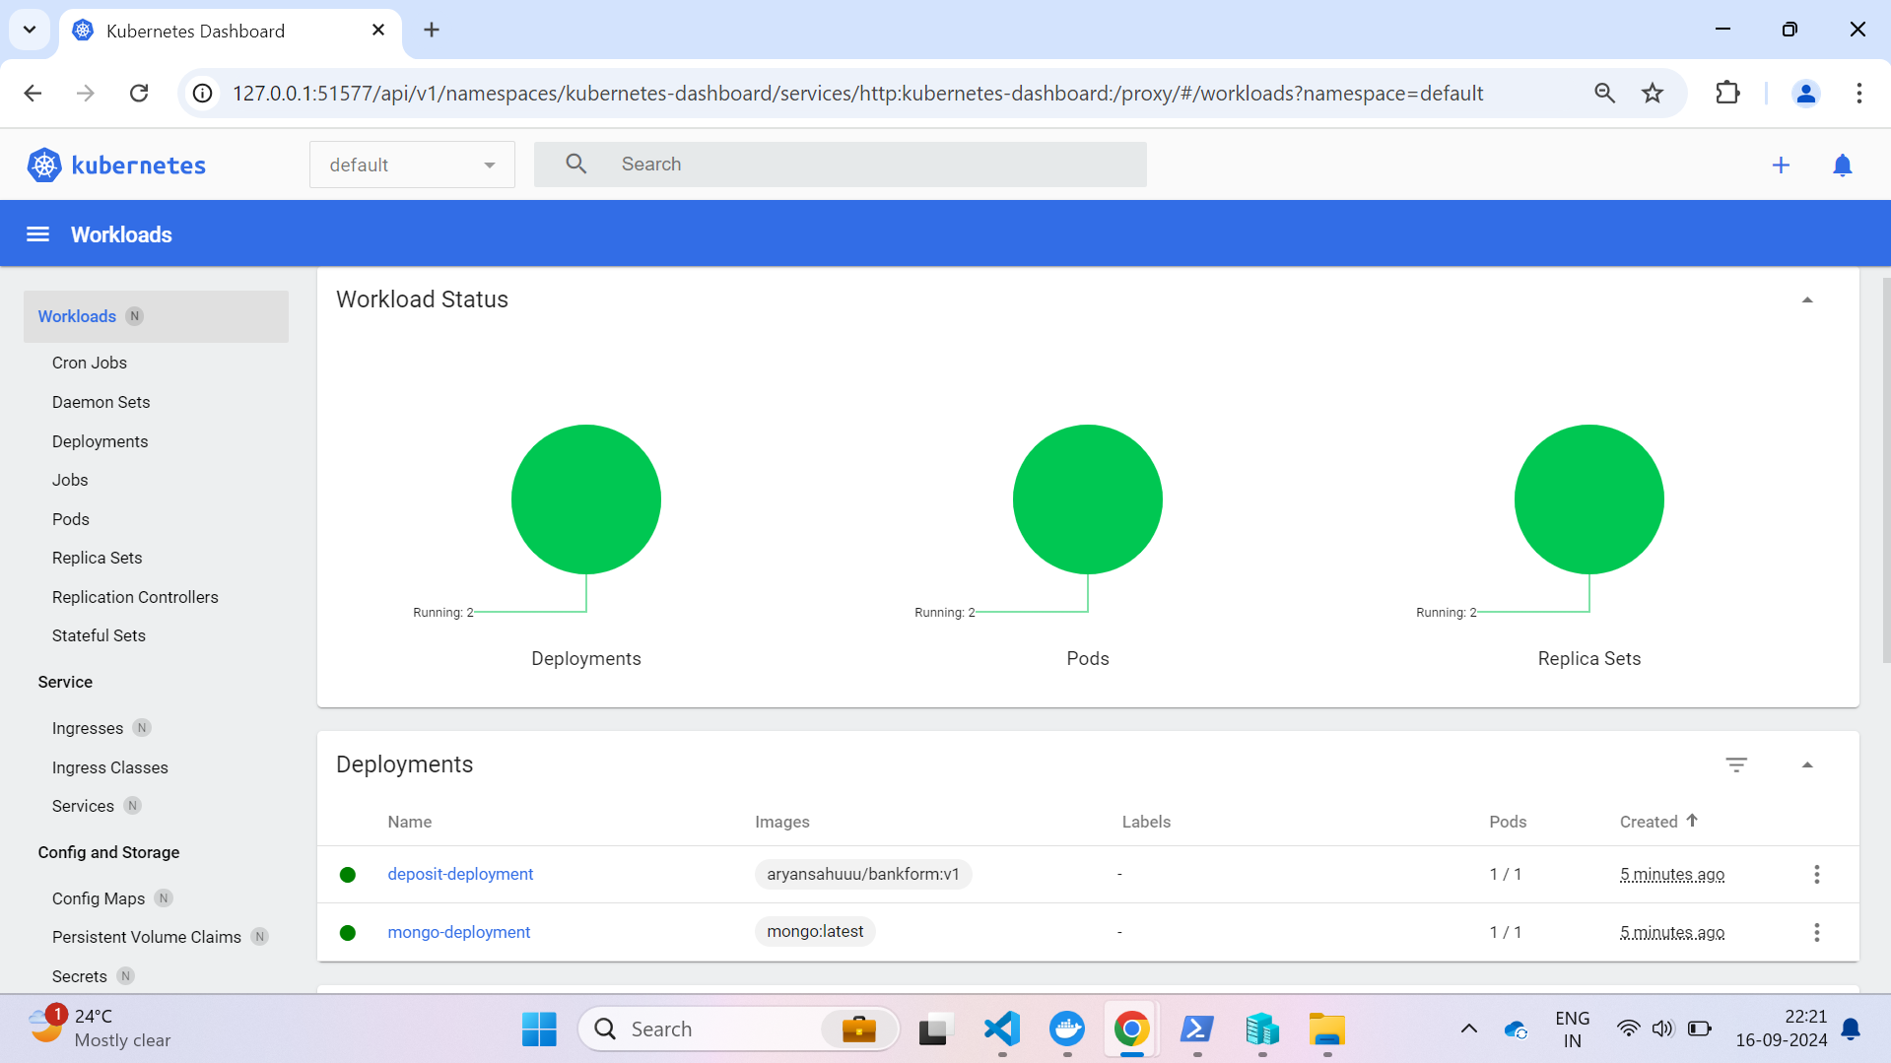

Slide 20

DATADOG & Monitoring

Slide 21
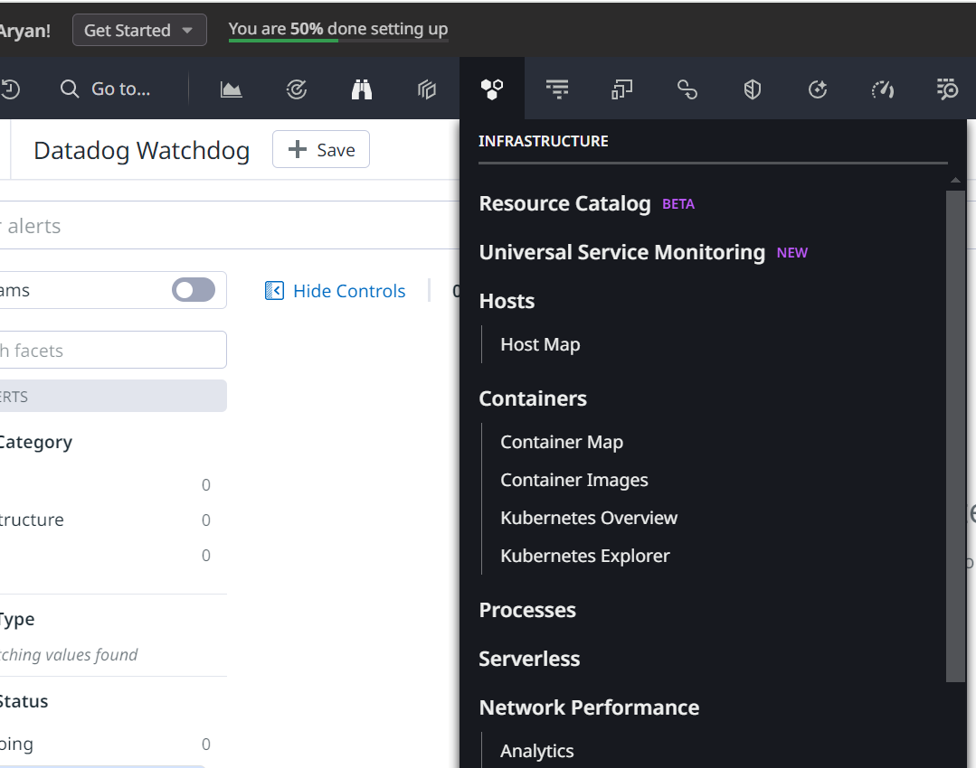

DataDog
DataDog is a cloud-based monitoring and analytics platform, which helps tracking servers, databases, tools, and services in real-time.
Features:
Monitoring: To monitor the performance and logs.
Dashboards: Real-time visualization of data.
Alerts: Notifications when thresholds are breached.
Integration: Supports over 500 services (AWS, Azure, Kubernetes, etc.)
Publicis
Sapient

Slide 22
IMPLEMENTATION OF DATADOG
First: Install docker and docker compose in AWS Linux Server
Agents: Now, install all the necessary agents on the servers or the cloud services to collect data.
Metrics & Logs: Analyzed in real-time and presented in dashboards.
Publicis
Sapient

Slide 23
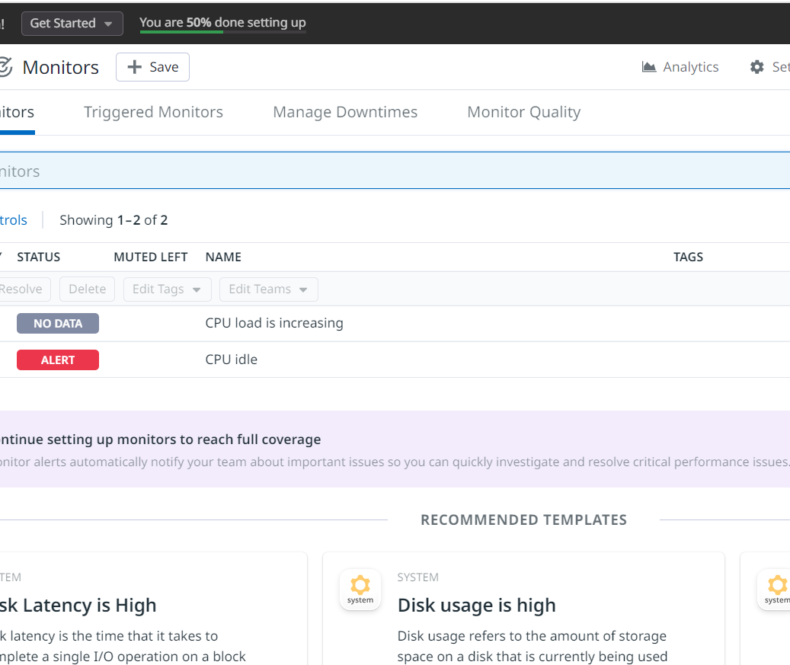
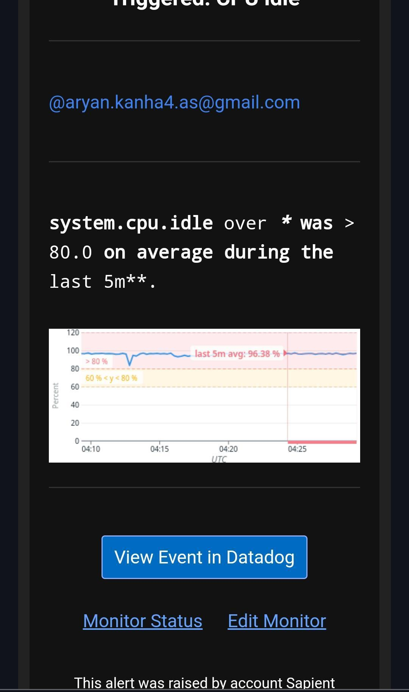
Monitoring

Slide 24
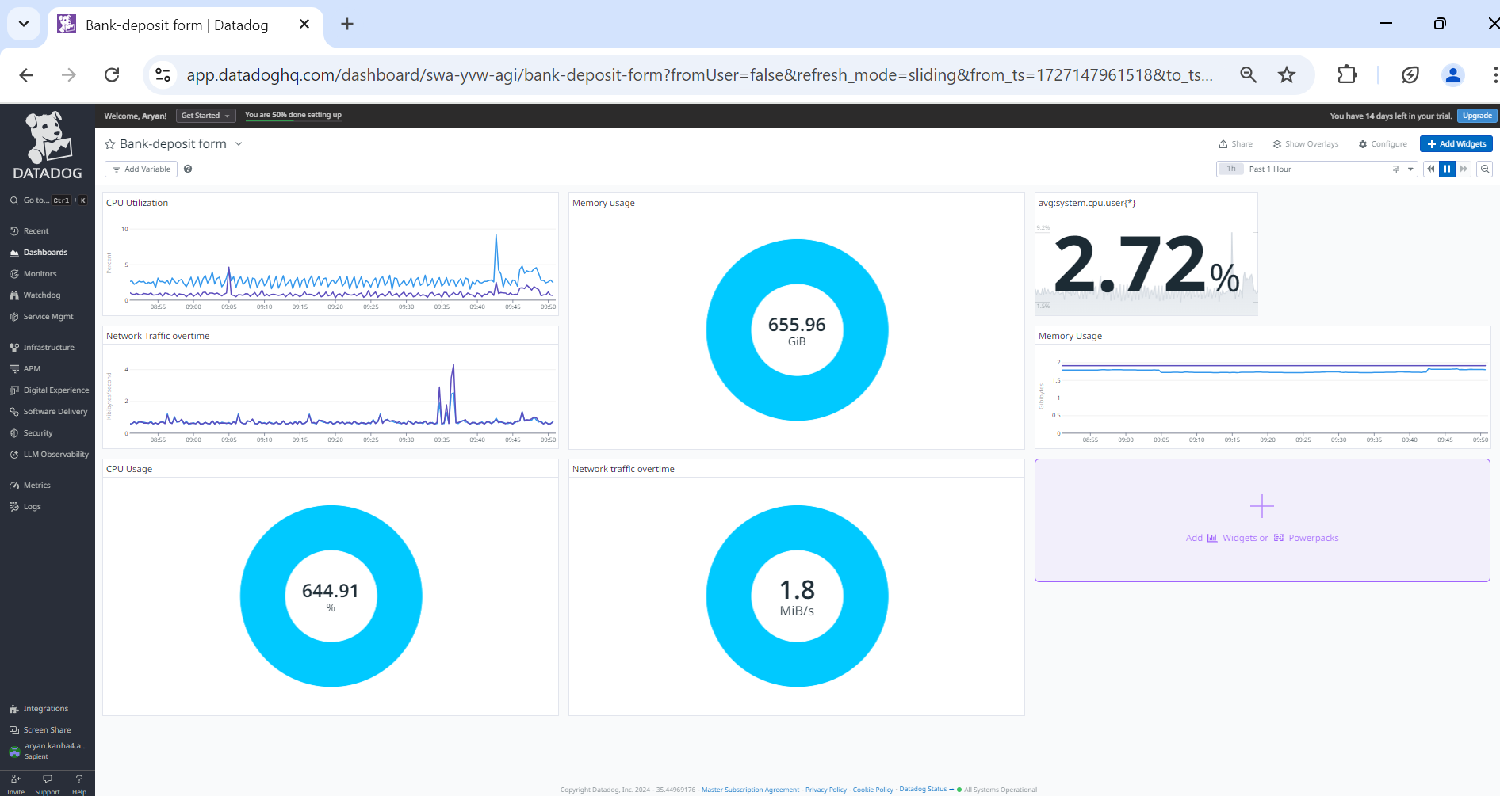
DashBoards

Slide 25
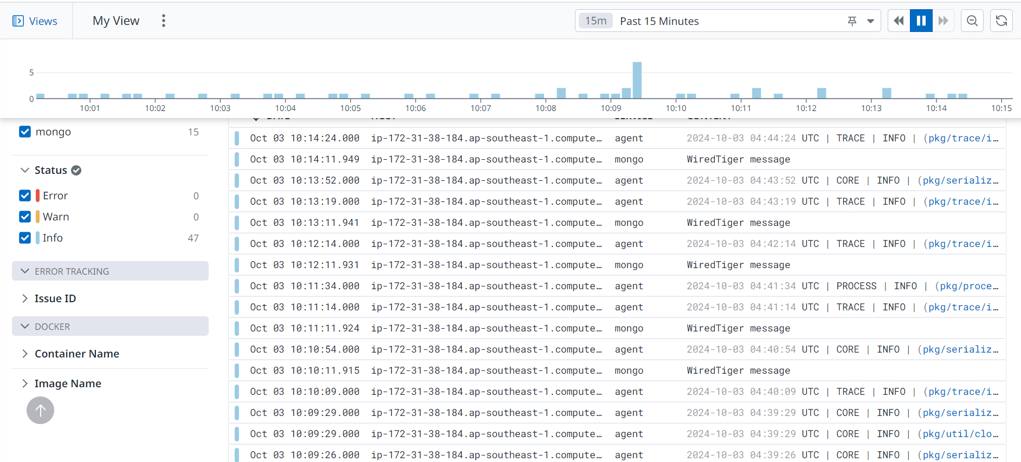

Slide 26
ServiceNow

Slide 27

ServiceNow:
ServiceNow is a cloud platform that helps organizations manage and automate their IT services and business processes.
Reason: Efficiency, consistency, scalability, cost reduction.
In addition to its core functionalities, ServiceNow provides four key management areas.
They are:
Incident Management: Restores normal service quickly after disruptions.
Change Management: Manages changes to IT Services with minimal risks.
Problem Management: Identifies and resolves root cause of incidents.
Release Management: Plans and controls the deployment of software updates.
Release management is generally represented in the form of a workflow.
Publicis
Sapient

Slide 28
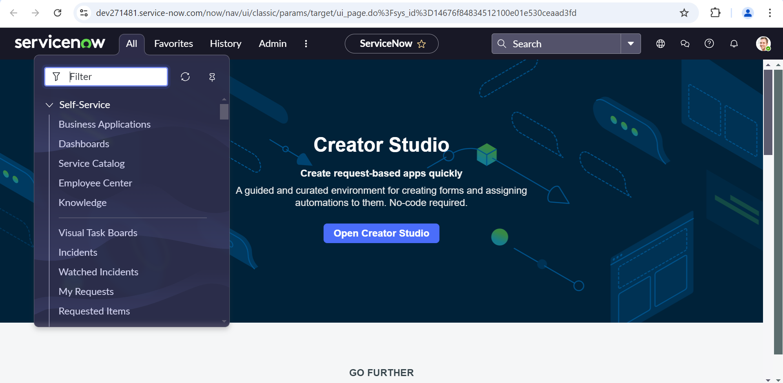

Slide 29
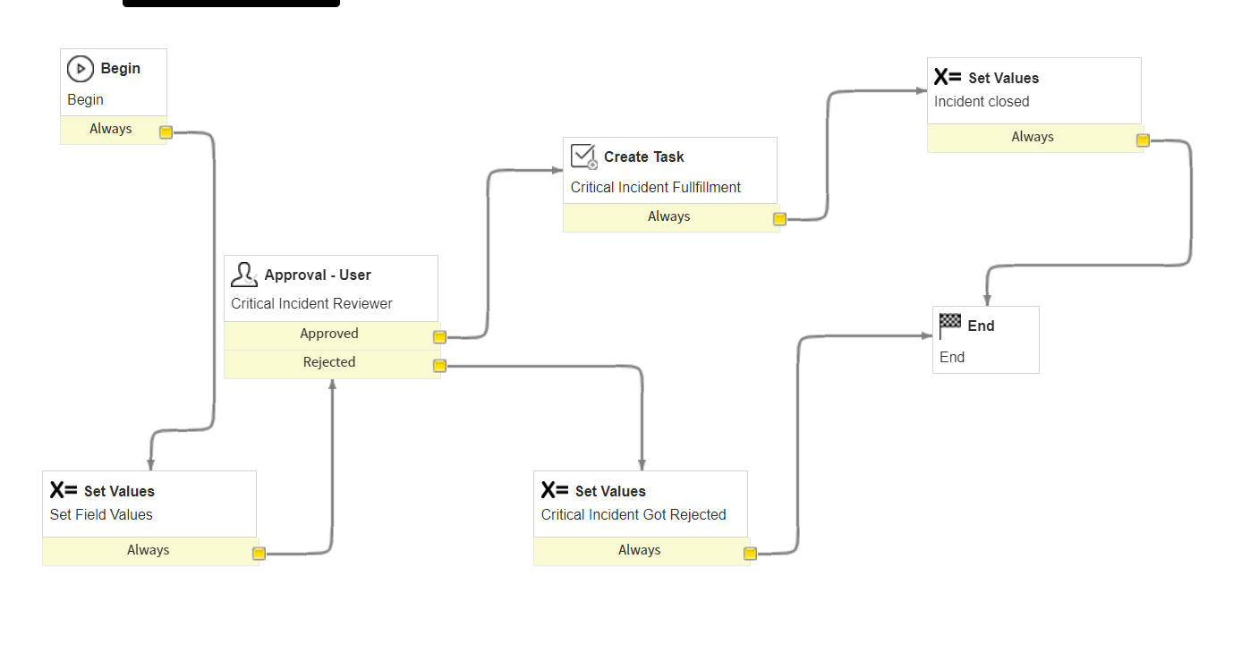

Slide 30
THANK YOU
Publicis
Sapient

